Slide 1

Website Development
September, 2022

Slide 2
Kxpilates is a pilates studio ( seems like gym ) that provide members with a high-end fitness experience and giving members a speedy and dynamic Pilates experience compared to more traditional clinical Pilates
Kxpilates want to create a website that can inform to potential customers about their service, find and book pilates class, and also informing about available location in some area.
Background

Slide 3
Clone kxpliates.com website
Showing some photos about kxpilates Indonesia from instagram to website
Maps for available location in town
Connect the booking system via hapana.com
Objective

Slide 4
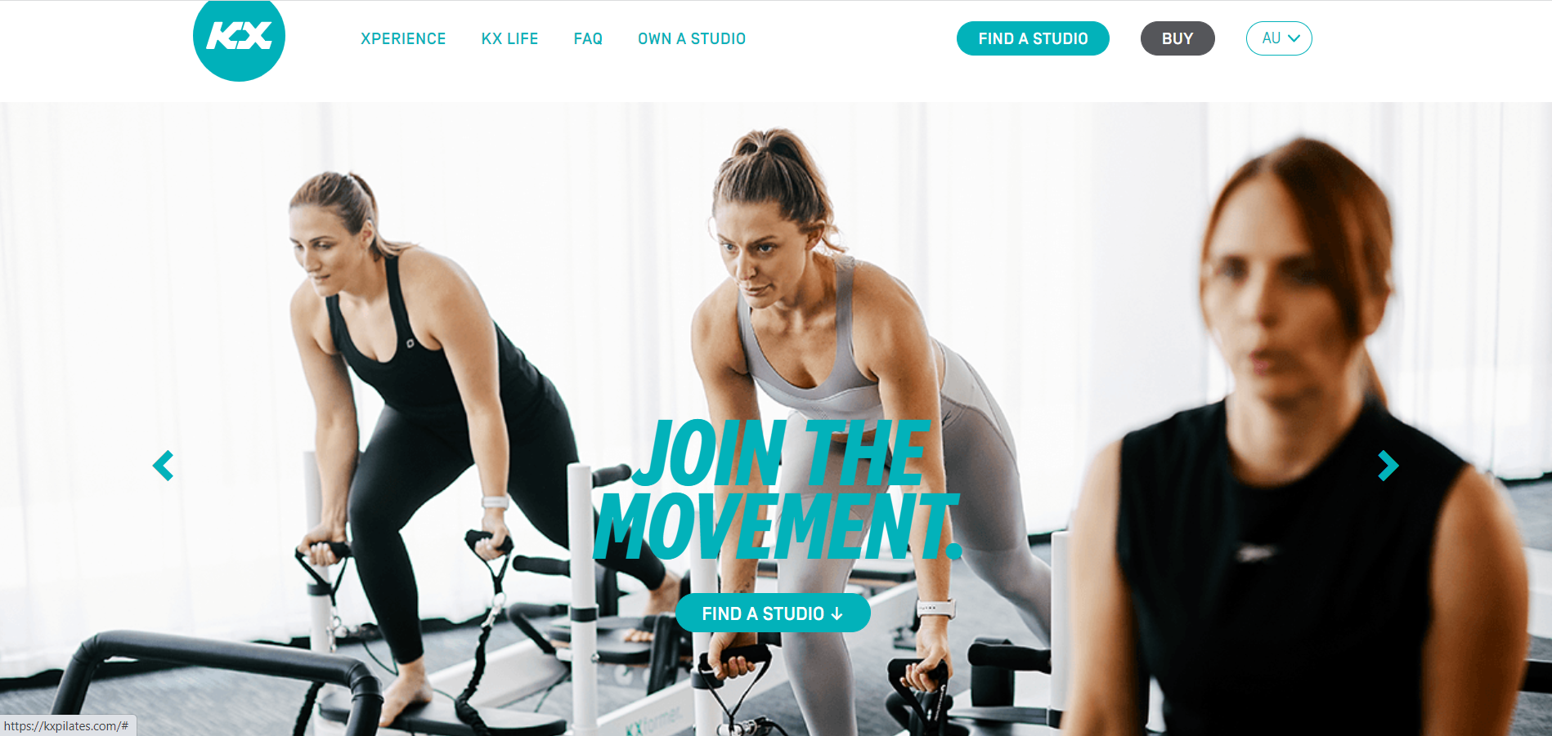
Solution

Slide 5
Development website will fully using wordpress (custom theme)
Technologies

Slide 6
No | Items | Unit | Price
1 | Web Development ( Include Maintenance 2 Month ) | Package | IDR 12,500,000
2. | Custom Theme | Package | IDR 750,000
3. | Maintenance (IDR 300.000 / month) (optional) | 6 months | IDR 1,800,000
4. | Enhancement Website | Per new modul | TBD (To Be Discuss)

Slide 7
Timeline
Development website
Maintenance
W1 Nov - W2 Nov
W2 Dec
W3 Dec-W4 Dec
W1 Feb - W4 Feb
W3 Nov
W1 Jan - W4 Jan
Web Requirements
Development start
Development, testing and deliver
Maintenance

Slide 8
Domain and hosting are include on client
Development that outside of offered in this offer
Partnering with 3rd party vendors
Out of Scope

Slide 9
trisakti.ac.id
crevio.id
pos.zatowaterbom.com
Our Reference

Slide 10
Mochammad Ali Hafidz
+6281331397765
moch.alihafidz@gmail.com
Contact

